Slide 1



Project Power BI
View in Power BI
Last data refresh:
2/16/2024 7:29:02 PM UTC
Downloaded at:
2/16/2024 7:35:28 PM UTC

Slide 2
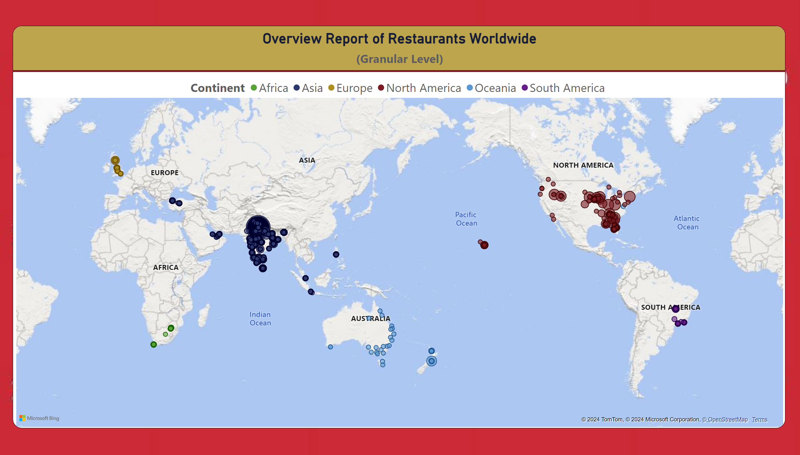
Restaurants Worldwide
Notes:
Overview Report of Restaurants Worldwide
No alt text provided

Slide 3
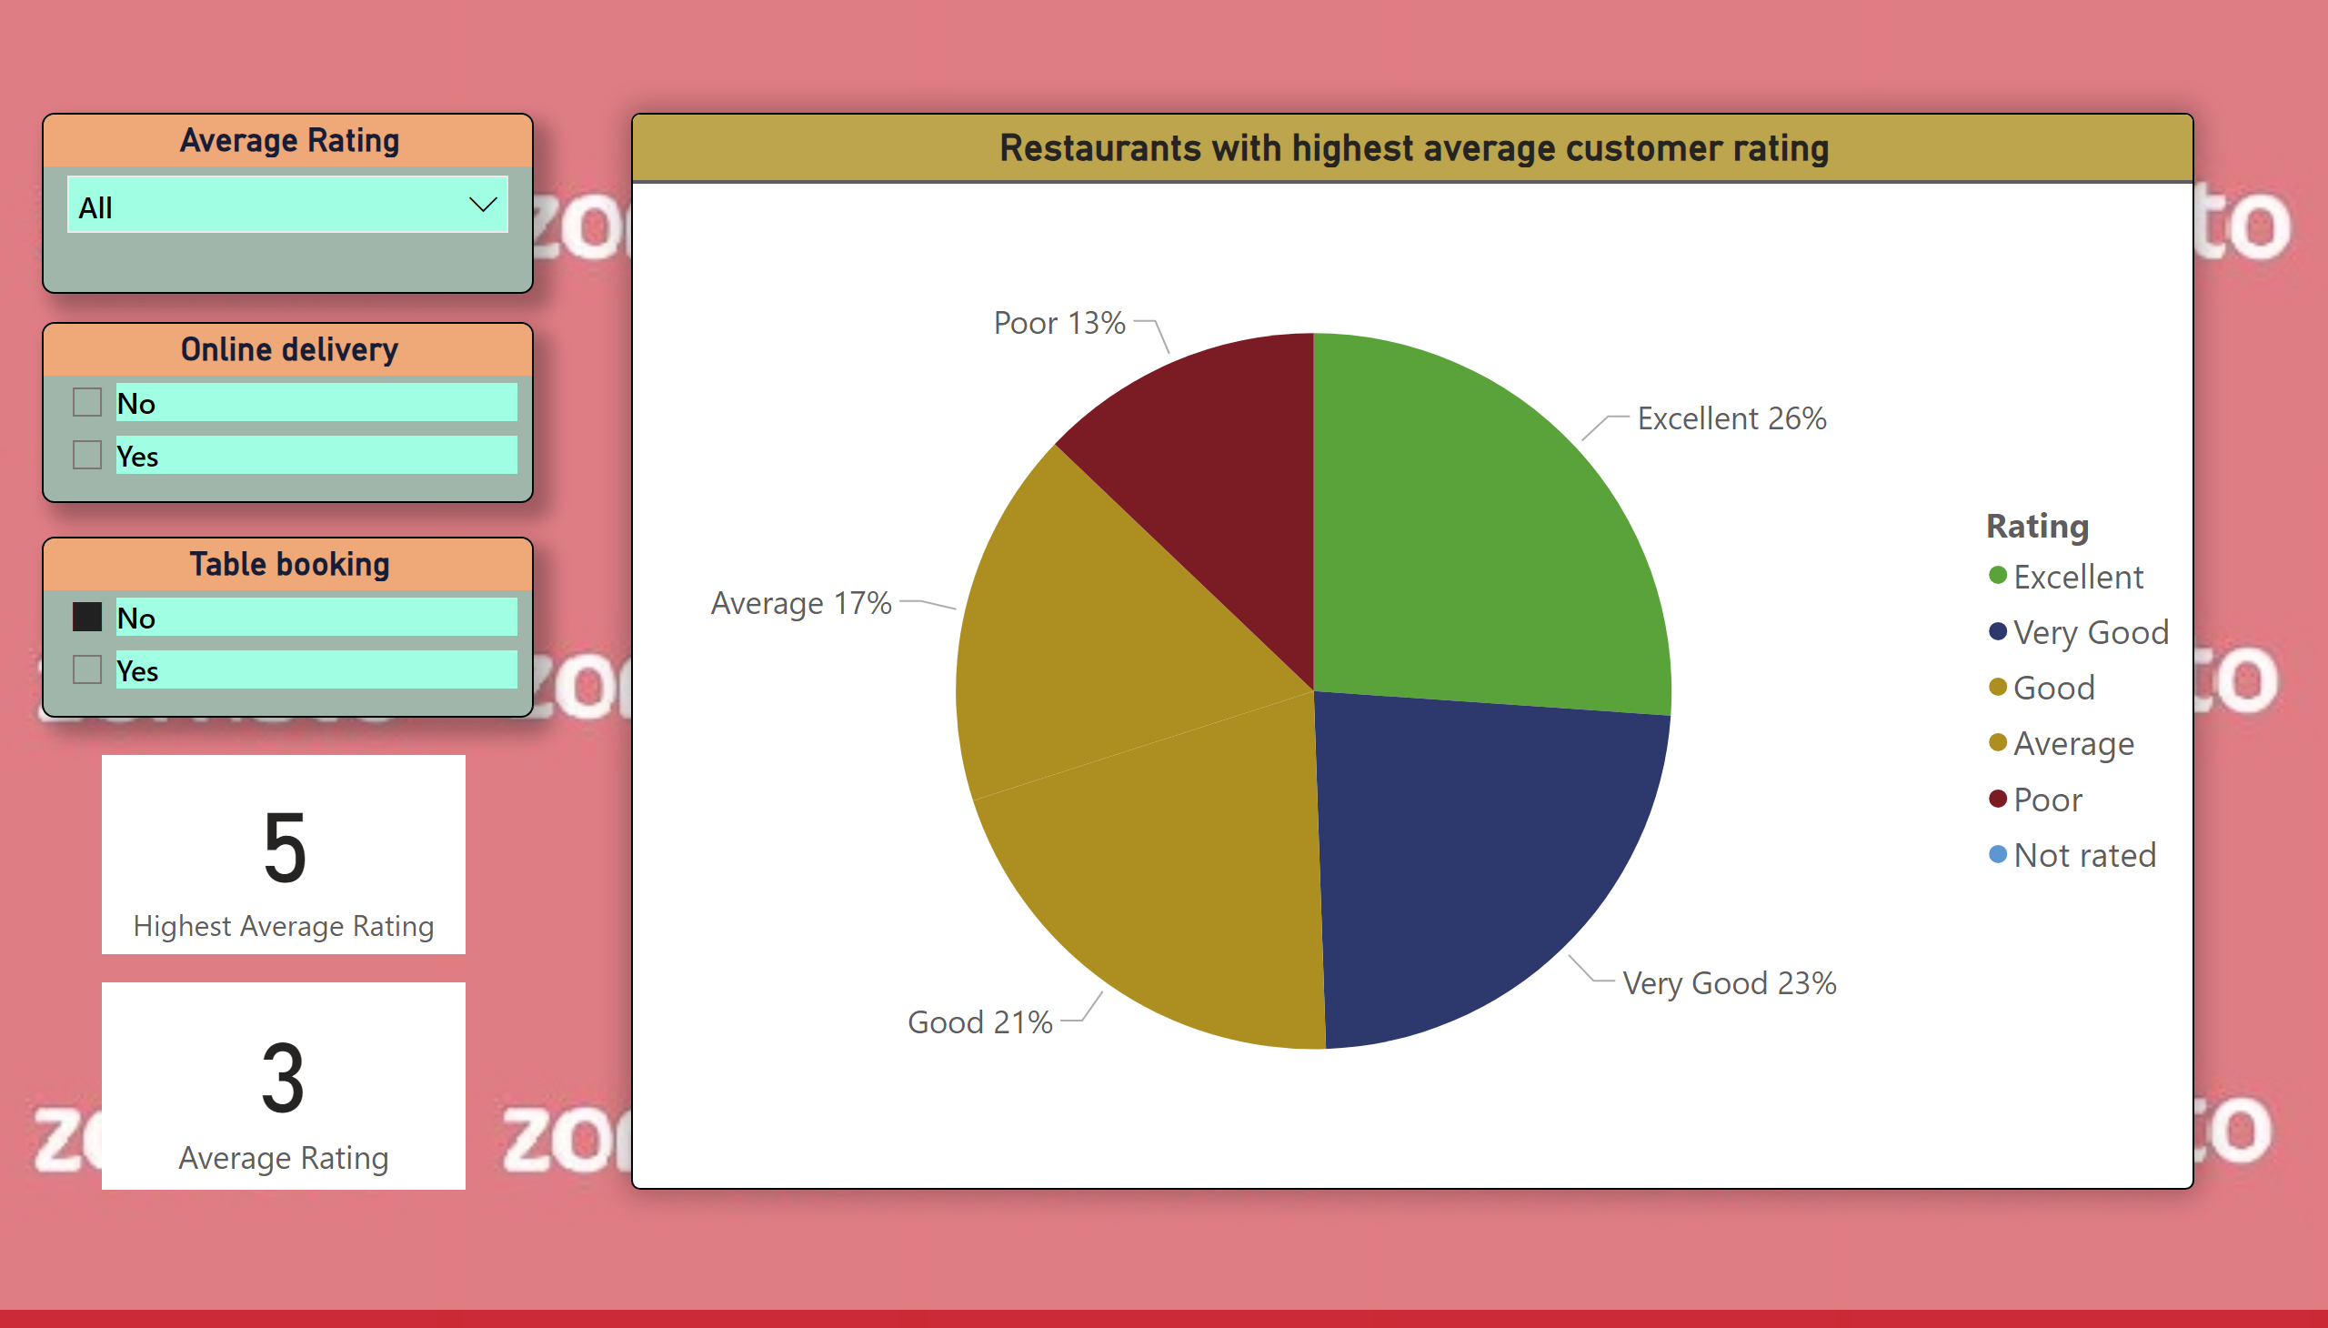
Highest Average Customer Ratings
Notes:
Restaurants with highest average customer rating
No alt text provided
Average Rating
No alt text provided
Online delivery
No alt text provided
Table booking
No alt text provided
card
No alt text provided
card
No alt text provided

Slide 4
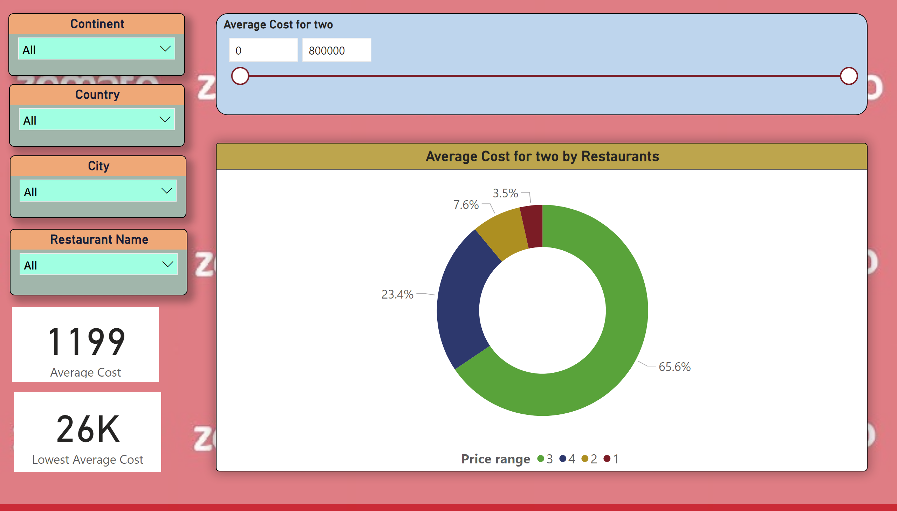
Lowest Average Costs
Notes:
Country
No alt text provided
Continent
No alt text provided
City
No alt text provided
Average Cost for two
No alt text provided
Average Cost for two by Restaurants
No alt text provided
Restaurant Name
No alt text provided
card
No alt text provided
card
No alt text provided

Slide 5
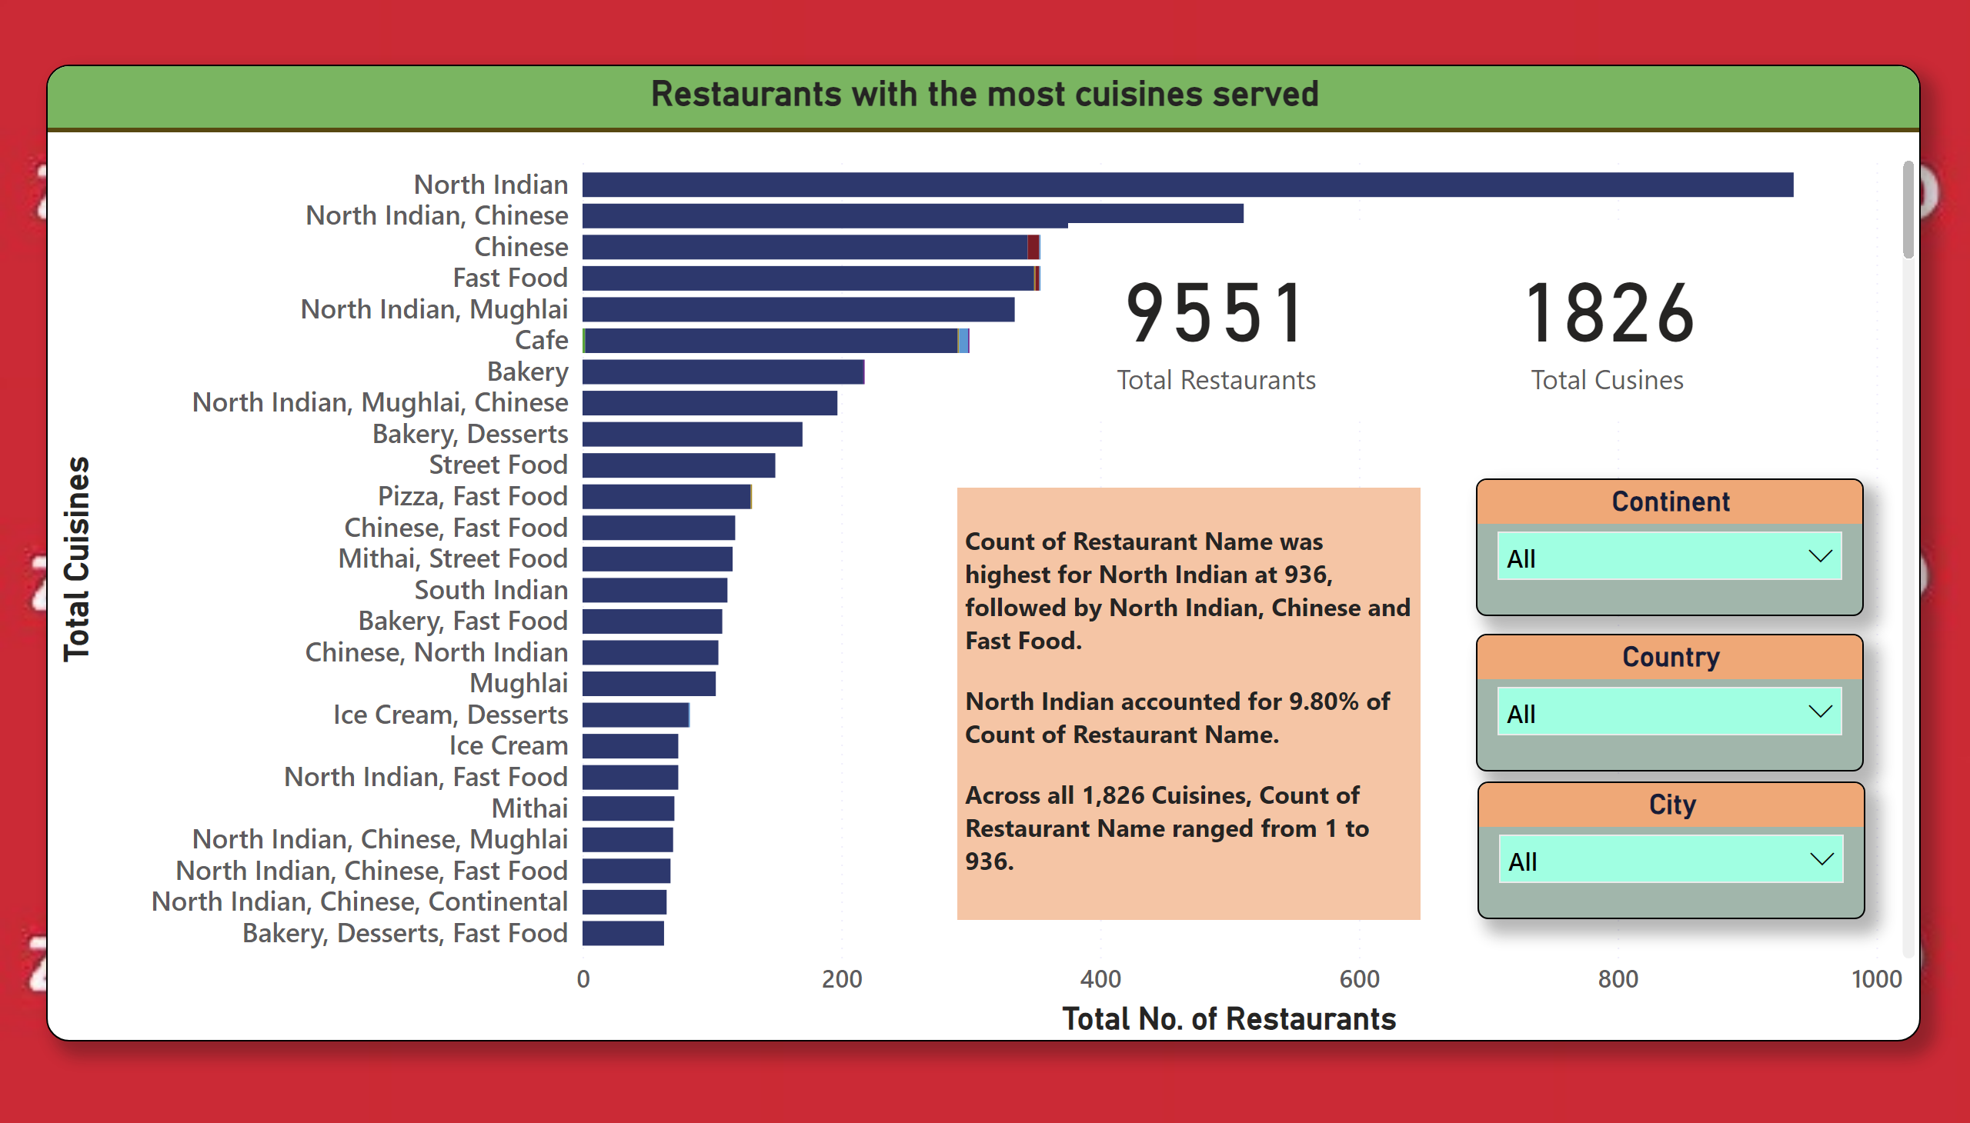
Most Cuisines Served Restaurant
Notes:
Restaurants with the most cuisines served
No alt text provided
textbox
No alt text provided
Continent
No alt text provided
Country
No alt text provided
City
No alt text provided
card
No alt text provided
card
No alt text provided

Slide 6
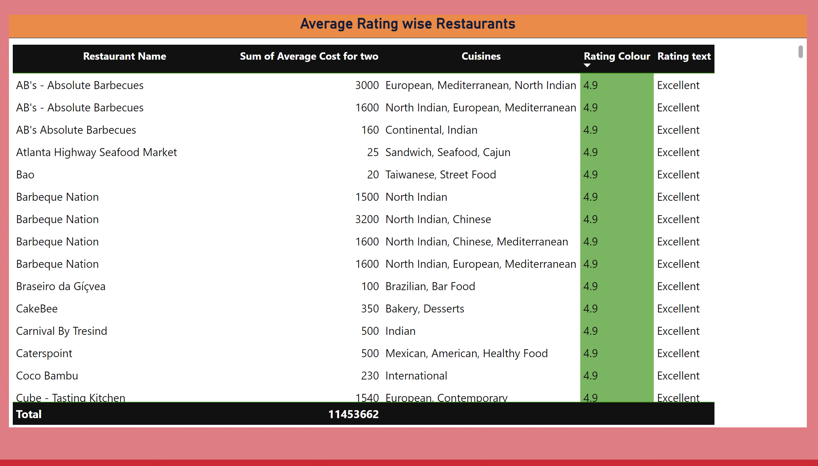
Table & Matrix
Notes:
Average Rating wise Restaurants
No alt text provided

Slide 7
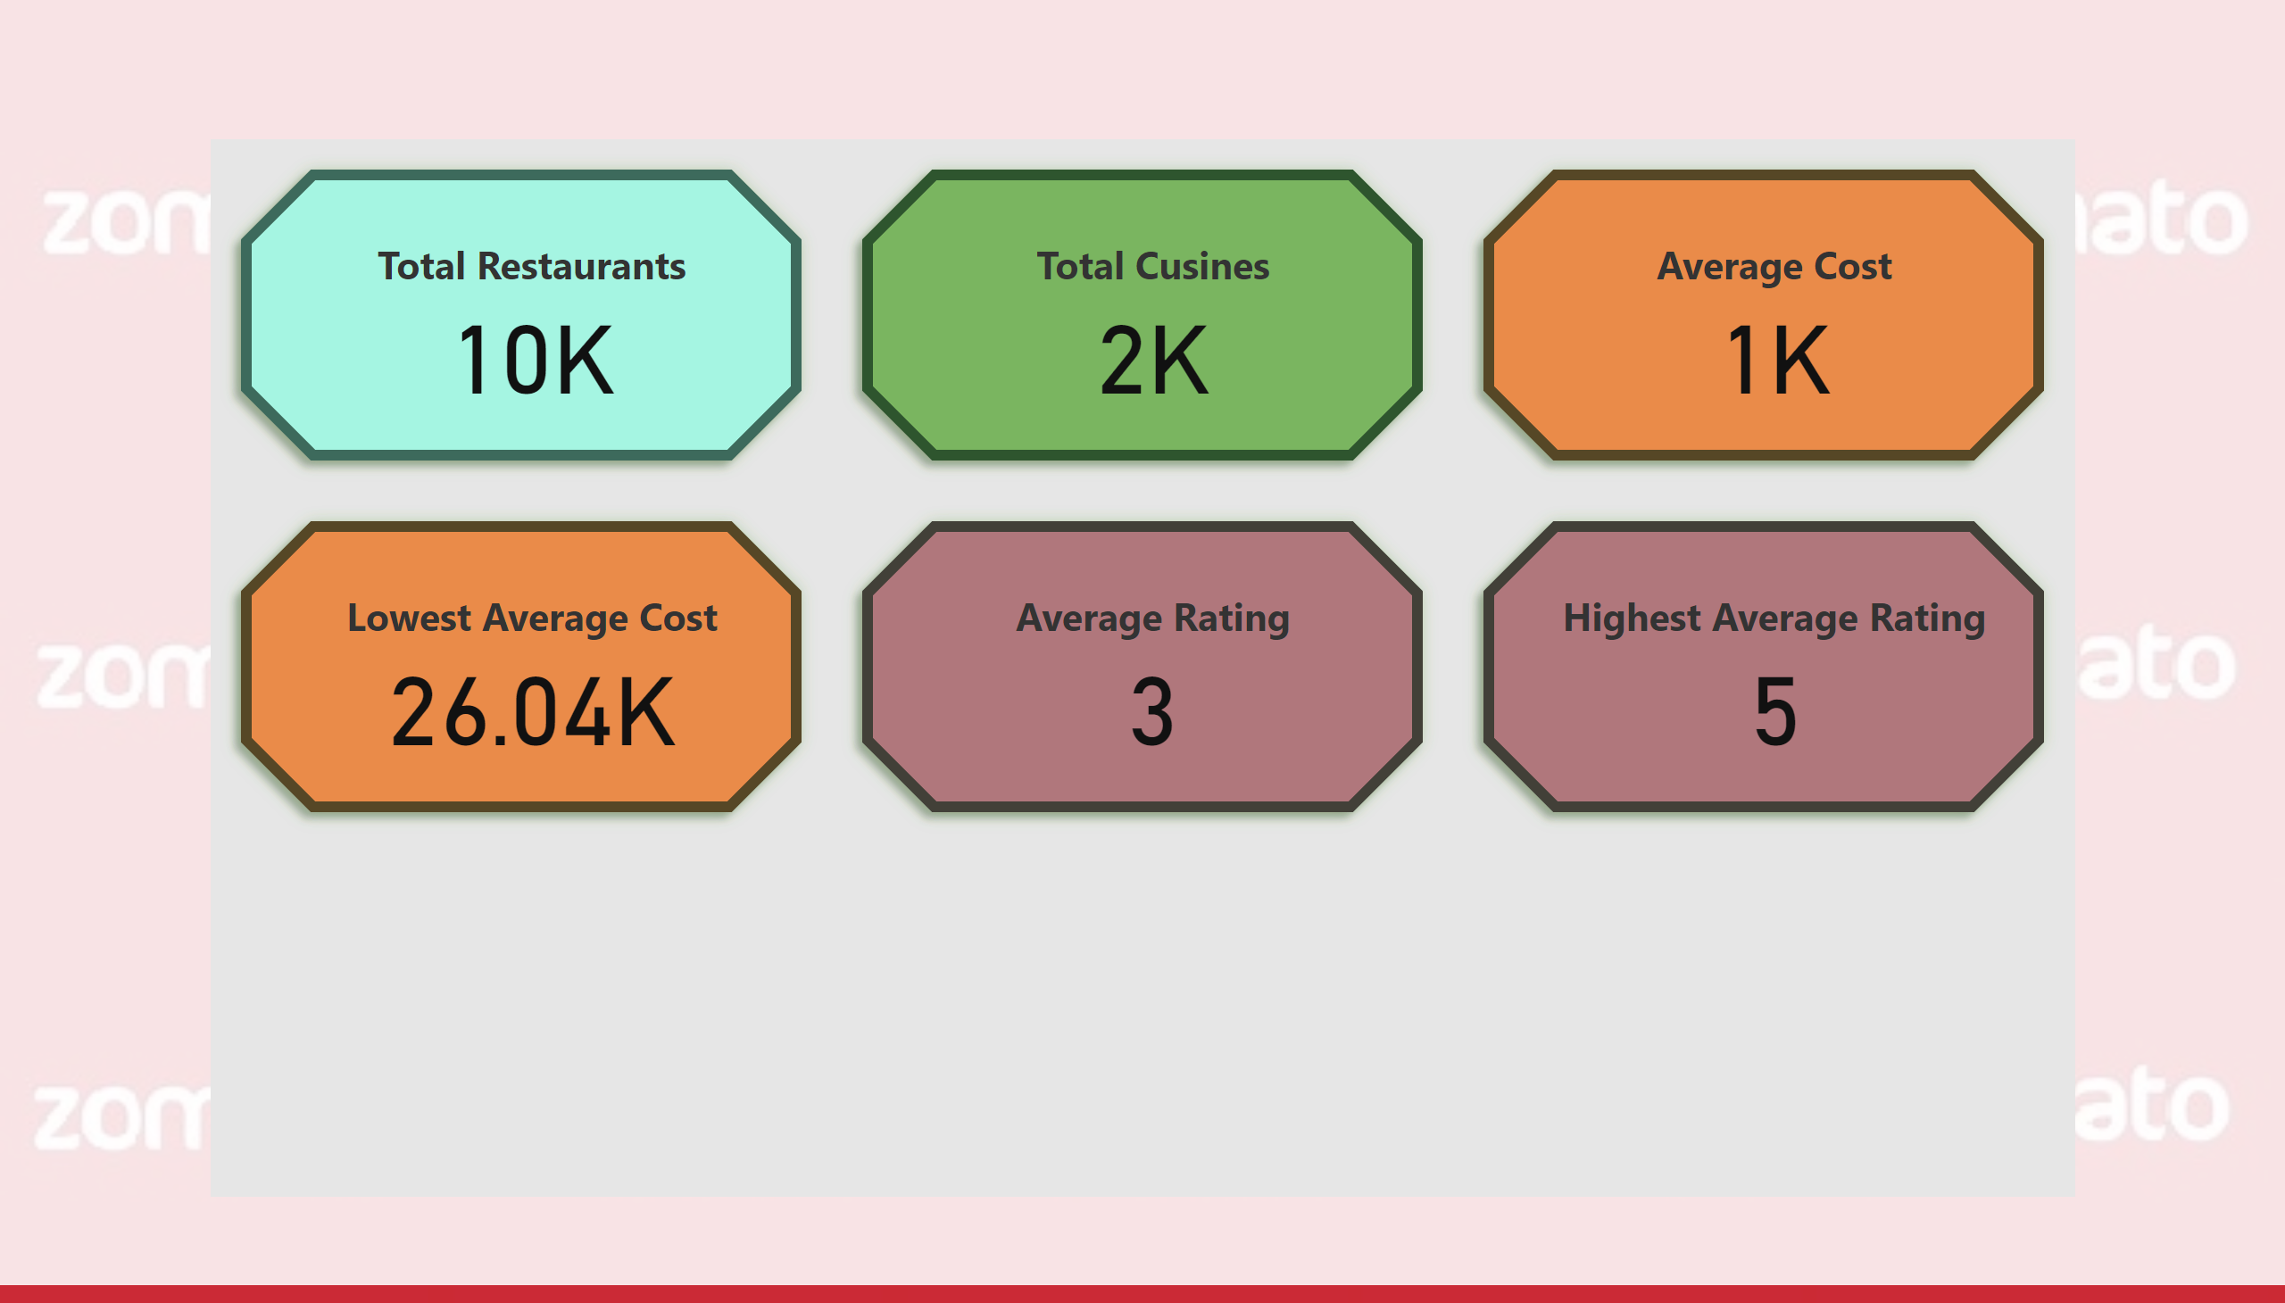
All Measures
Notes:
cardVisual
No alt text provided

